Slide 1

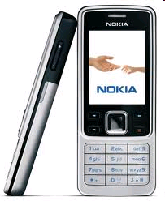
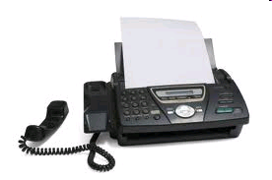
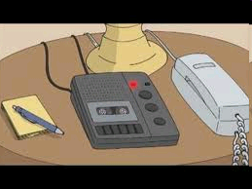

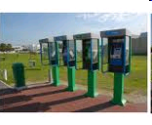
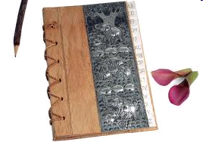
UNIT 2 : MAKING ARRANGEMENTS
Lesson 1: Getting started & Listen and read.
*Matching:
a fax machine
an address book
a telephone directory
a public telephone
a mobile phone
an answering machine
a
b
c
d
e
f

Slide 2


UNIT 2 : MAKING ARRANGEMENTS
Lesson 1: Getting started & Listen and read.
Vocabulary
- (to) arrange (v):
sắp xếp, thu xếp
- (to) hold on (v):
hãy giữ máy
- directory (n) :
danh bạ điện thoại
- mobile (n) :
di động
- (to) introduce (v):
giới thiệu

Slide 3

UNIT 2 : MAKING ARRANGEMENTS
Lesson 1: Getting started & Listen and read.
Vocabulary
arrange
mobile
introduce
directory
hold on

Slide 4
UNIT 2 : MAKING ARRANGEMENTS
Lesson 1: Getting started & Listen and read.
Vocabulary
2
arrange
1
mobile
3
introduce
4
directory
hold on
5

Slide 5



UNIT 2 : MAKING ARRANGEMENTS
Lesson 1: Getting started & Listen and read.
Hoa
Nga
Nga and Hoa are talking on the phone.
Hoa invites Nga to see the movie.
they are making arrangements .

Slide 6
UNIT 2 : MAKING ARRANGEMENTS
Lesson 1: Getting started & Listen and read.
T/F Statements prediction :
T / F
1.Hoa’s telephone number is 3 847 339
F
3 847 329
2.They are going to see Dream City at Sao Mai Movie Theater.
T
3.Hoa’s going to see the movies by bike
T
4.They’re going to meet inside the theater at 6.30.
F
outside

Slide 7
UNIT 2 : MAKING ARRANGEMENTS
Lesson 1: Getting started & Listen and read.
Hoa
Nga
Nga and Hoa are talking on the phone.
Hoa invites Nga to see the movie.
they are making arrangements .

Slide 8
UNIT 2 : MAKING ARRANGEMENTS
Lesson 1: Getting started & Listen and read.
Answer the questions
a, Who made the call?
b, Who introduced herself?
c, Who invited the other to the movies?
d, Who arranged a meeting place?
e, Who arranged the time?
f, Who agreed to the time?

Slide 9
UNIT 2 : MAKING ARRANGEMENTS
Lesson 1: Getting started & Listen and read.
1
2
3
4
Lucky number
5
6
7
8

Slide 10



Who introduce herself ?
Nga.
TRỞ VỀ

Slide 11


Who made a call ?
- Nga.
TRỞ VỀ

Slide 12
Who invited the other to the movies ?
- Nga.
TRỞ VỀ

Slide 13
Who arranged a meeting place ?
- Nga.
TRỞ VỀ

Slide 14
Who arranged the time ?
- Hoa.
TRỞ VỀ

Slide 15
Who agreed to the time ?
- Nga.
TRỞ VỀ

Slide 16



TRỞ VỀ

Slide 17
TRỞ VỀ

Slide 18


Homework
Learn by heart the new words.
- Prepare: Speak & Listen

